Slide 1
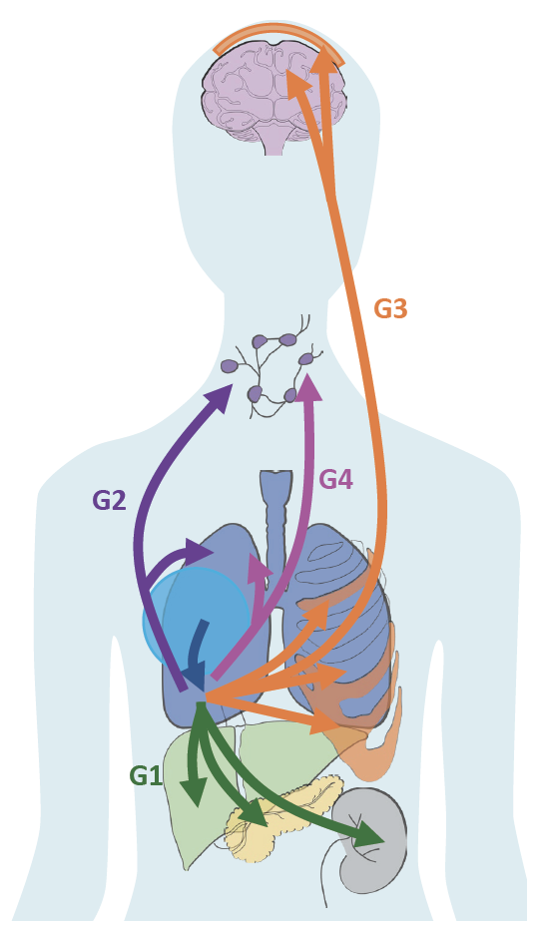
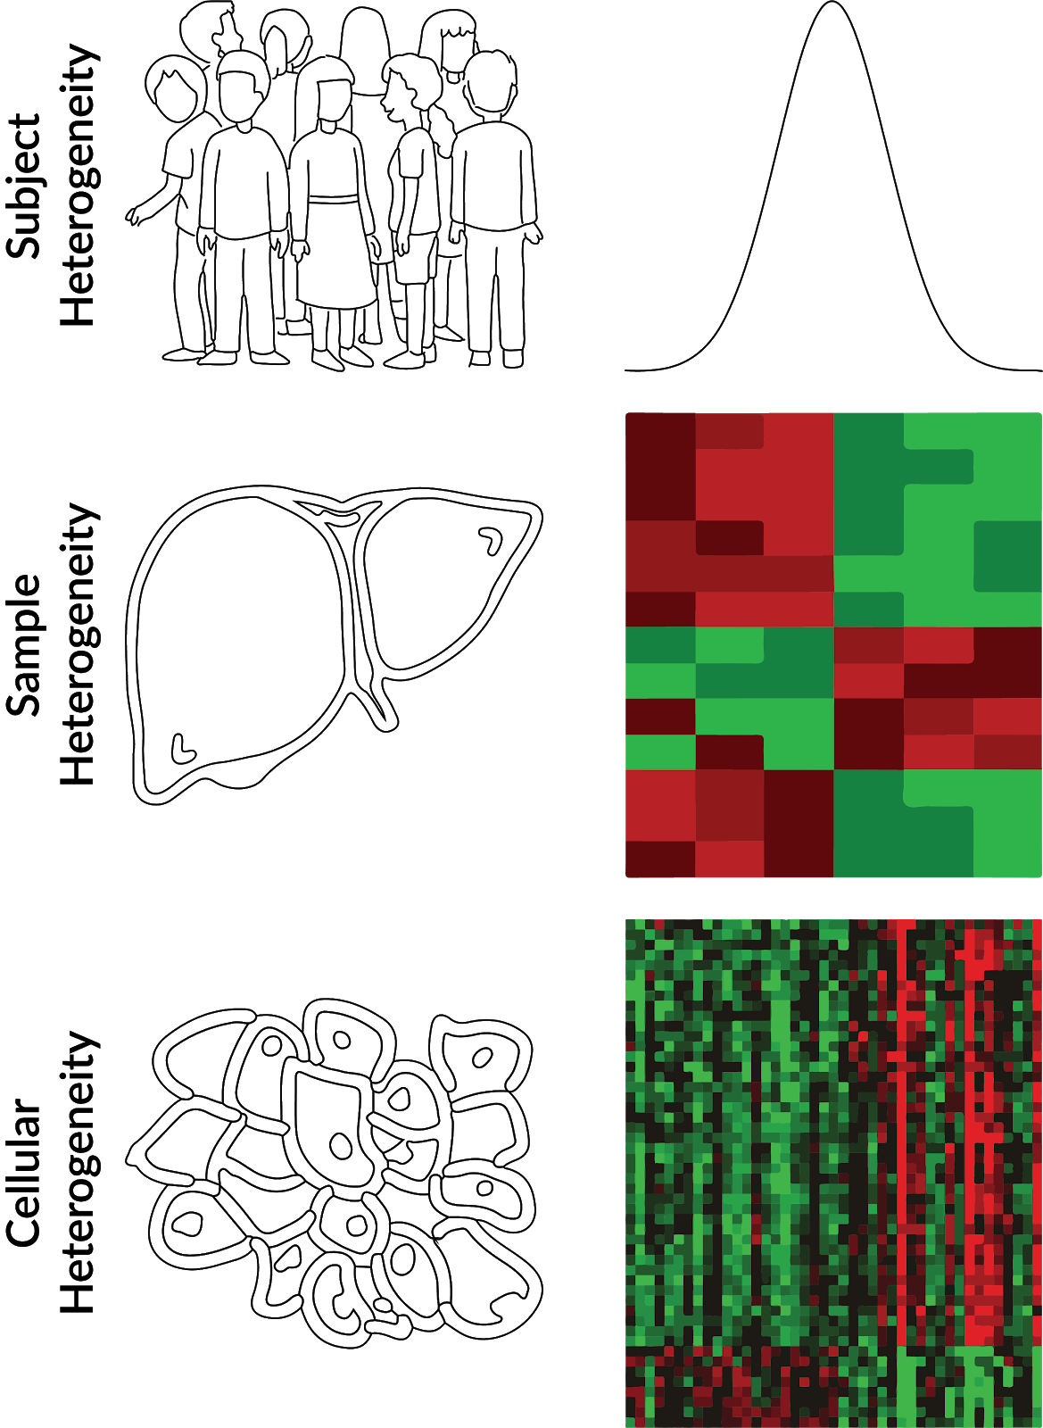
Heterogeneity

Slide 2
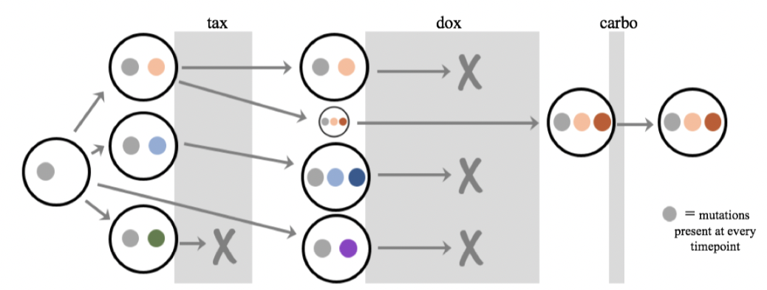
Tumor Heterogeneity
Question: What is the functional impact of tumor evolution?

Slide 3
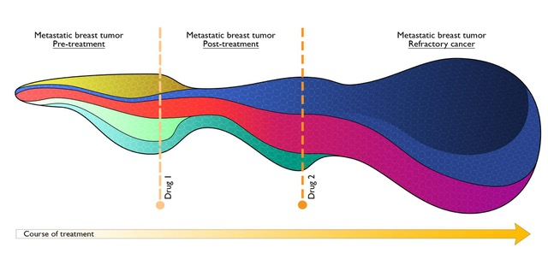
Tumor Heterogeneity
Metastatic breast tumor
Pre-treatment
Metastatic breast tumor
Post-treatment
Metastatic breast tumor
Refractory cancer
Drug 1
Drug 2
Course of treatment

Slide 4
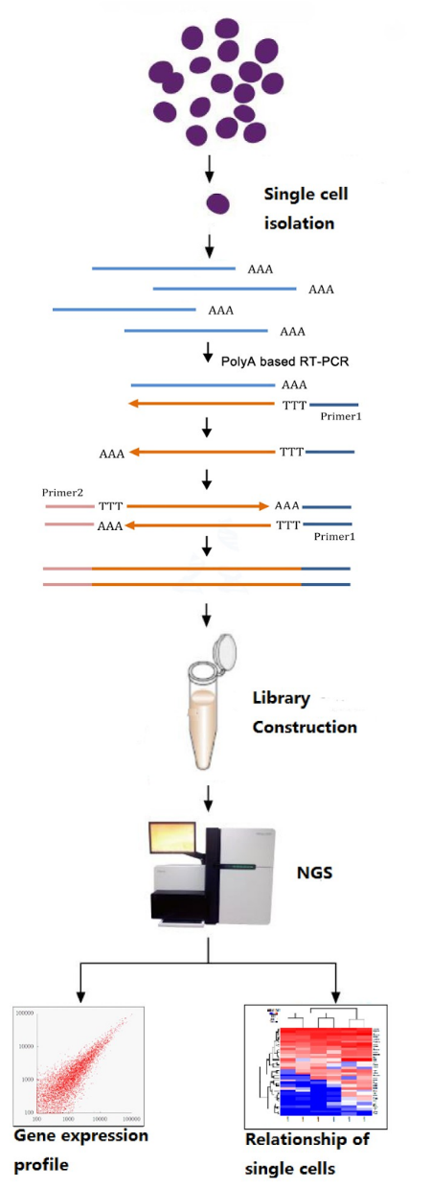
Single Cell Profiling
Applications for Single Cell Sequencing:
Cancer: intra-tumoral heterogeneity
Development: characterize every cell in blastocyst
Other applications: novel/rare cell type discovery
Infectious Diseases: combine with metagenomics to explore host response (e.g. TB)
And more!
The Future of RNA-sequencing

Slide 5
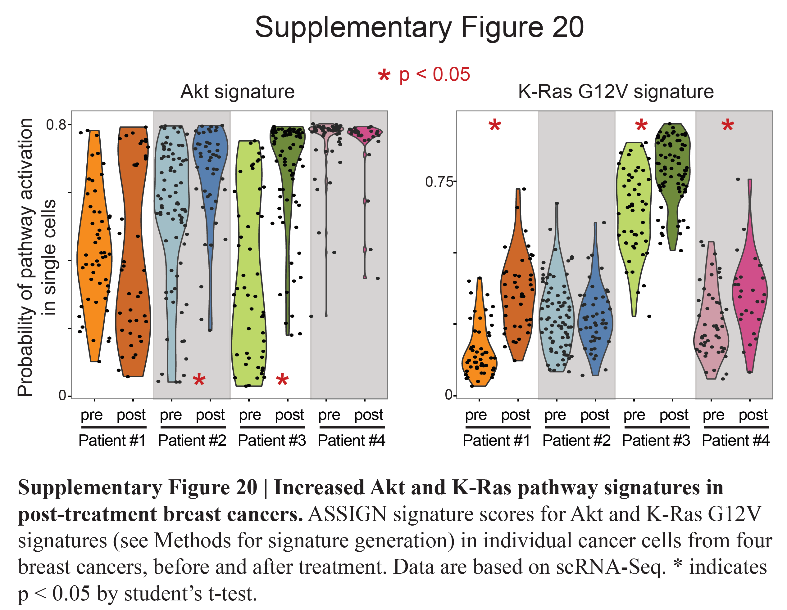
Pathway Activity in Breast Cancer
Brady S, et al. Combating subclonal evolution of resistant cancer phenotypes. Nat Commun. 2017
Notes:
receptor tyrosine kinase (RTK)
epithelial-mesenchymal transition (EMT)
apoptosis signatures
See the tumor evolving over time at a pathway level
Breast cancer patient treated over more than two years
Tumor tissue sequenced at six timepoints over treatment after different drug regimends
Increased cell proliferation after taxane treatment (chemotherapy, inhibits microtubule function)
After doxorubicin, Increase EGFR, IGFR, growth factor receptor activity after (chemotherapy, inhibits transcription via inhibition of topoisomerase II)
after carboplatin + gemcitabine treatment Increased anti-apoptosis signaling and decreased bad activity ()
Example of how RNA-Seq of the tumor over time and analysis for pathway activity could inform the choice of drug and help doctors see how the tumor is changing after each treatment
Important to mention that these are pleural effusions
White blood cells in these samples? in pleural effusions expect 80%
correlation of bulk with combined (average) single cell
if you were to analyze patients together, use hierarchical model
maybe separate plots by individual! clearly explain that we are not comparing
how level of heterogeneity decreases over time might be an interesting measure

Slide 6
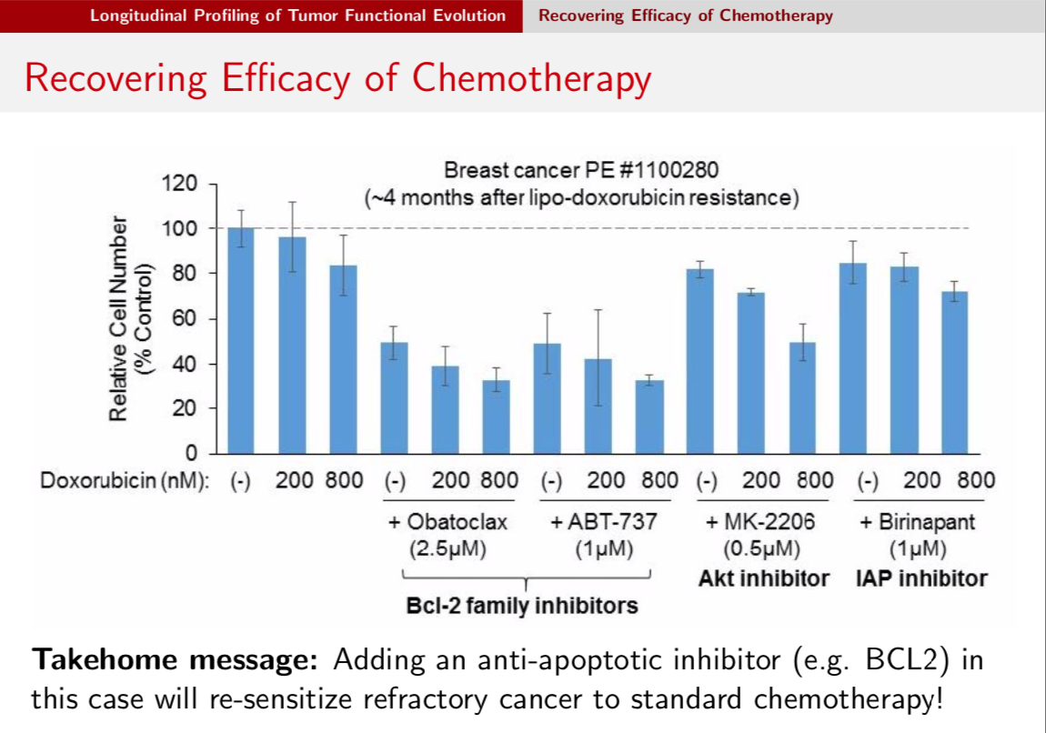

Slide 7
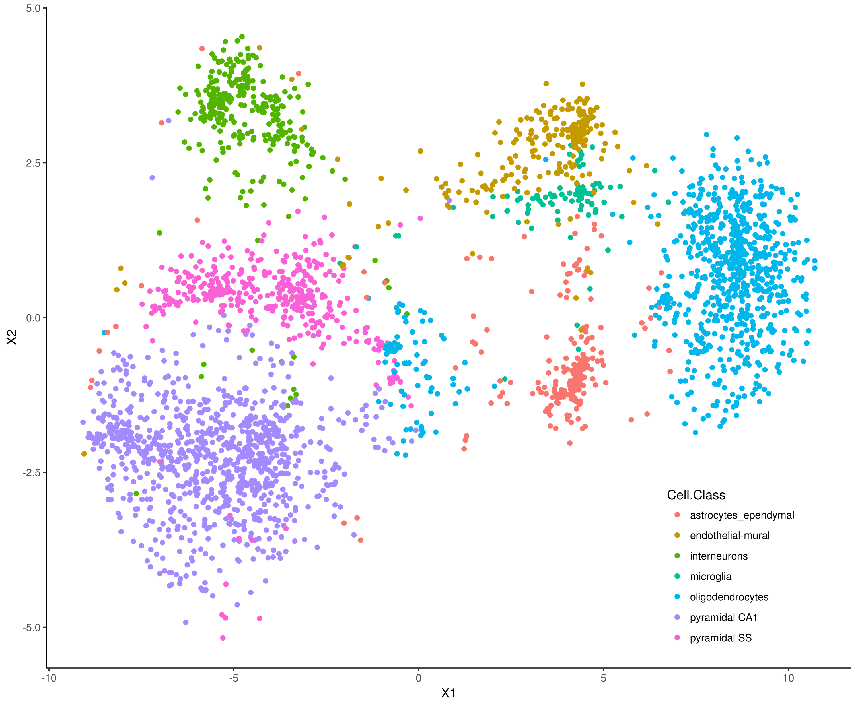
Critical Gaps in scRNA-seq data
Complex data
New analysis challenges
Interactive, Simple Analysis?
Inexperienced Users
Optimizing Parameters
Filtering Failed Samples
Filtering Low expression genes
Some packages already exist
QC
Clustering
Full Analysis Portal?

Slide 8
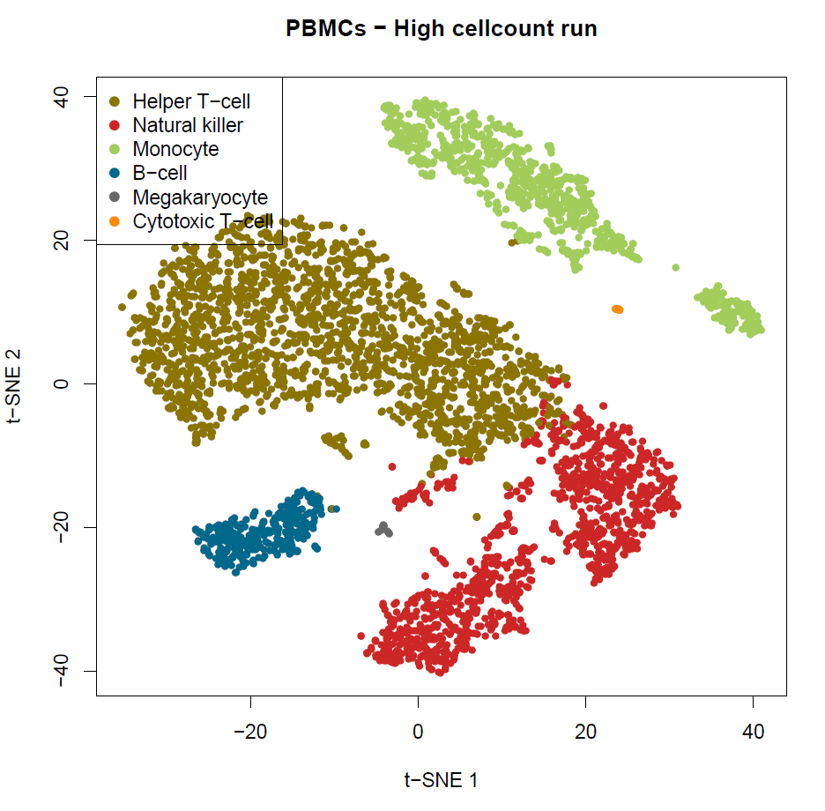
Clustering consistency in PBMCs
First dataset produced by the Single Cell Sequencing Core:
10X Genomics
2 PBMC datasets, each given one NextSeq run:
“HIGH”: ~5,000 cells (27,000 reads/cell)
“LOW”: ~800 cells (120,000 reads/cell)
First pass analysis: Cell Ranger

Slide 9
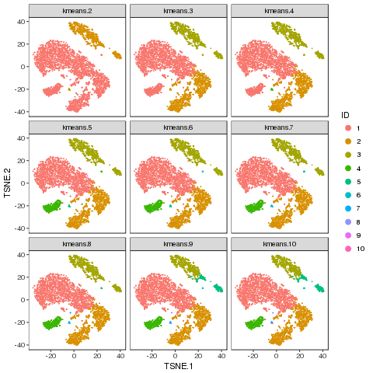
Complicating factor: cell typing/clustering
“Cell type” isn’t always clear-cut
Overlapping transcriptional clusters
When is a cluster a new subtype vs arbitrary splitting
Can rely on expert knowledge and manual designation
Necessary in order to perform diffExp or differential abundance
Notes:
Clustering or classification! But with the noisiness and batch-batch variation, clustering is probably better? See what’s actually in your data, rather than fitting it to expectations.

Slide 10
Single Cell Toolkit
Standard R package with a Shiny toolkit
R functions on top of a SingleCellExperiment (SCE) object
Can download analysis performed in the toolkit and continue on the command line
SCE object can be brought in/out of Shiny at any stage
Great for common tasks:
Interactive clustering/visualization
Differential gene/pathway analysis
(Also works for bulk RNA-seq analysis)

Slide 11
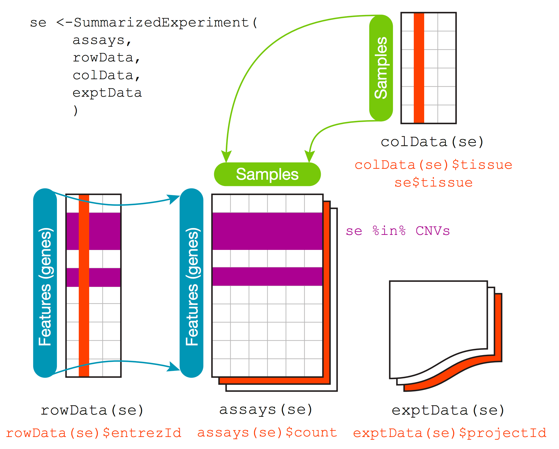
SummarizedExperiment
Notes:
Similar to ExpressionSet
More modern, not specifically made for microarray data, just general matrix data with row and column annotations
Can easily extend, MAST extends this object

Slide 12
MultiAssayExperiment
Combine multiple data types in similar objects with functionality to query across features and cells.
Notes:
Similar to ExpressionSet
More modern, not specifically made for microarray data, just general matrix data with row and column annotations
Can easily extend, MAST extends this object

Slide 13
SingleCellExperiment
https://bioconductor.org/packages/devel/bioc/html/SingleCellExperiment.html
reducedDims
PCA, TSNE, any other sample size matrix of dimensionality reduction data
isSpike – indicate which probes are spike ins
sizeFactors – add scaling factors
Named assays: counts, normcounts, logcounts, cpm, tpm
Just a convention
DelayedArray – run common array functions without loading it into memory
Notes:
Similar to ExpressionSet
More modern, not specifically made for microarray data, just general matrix data with row and column annotations
Can easily extend, MAST extends this object

Slide 14
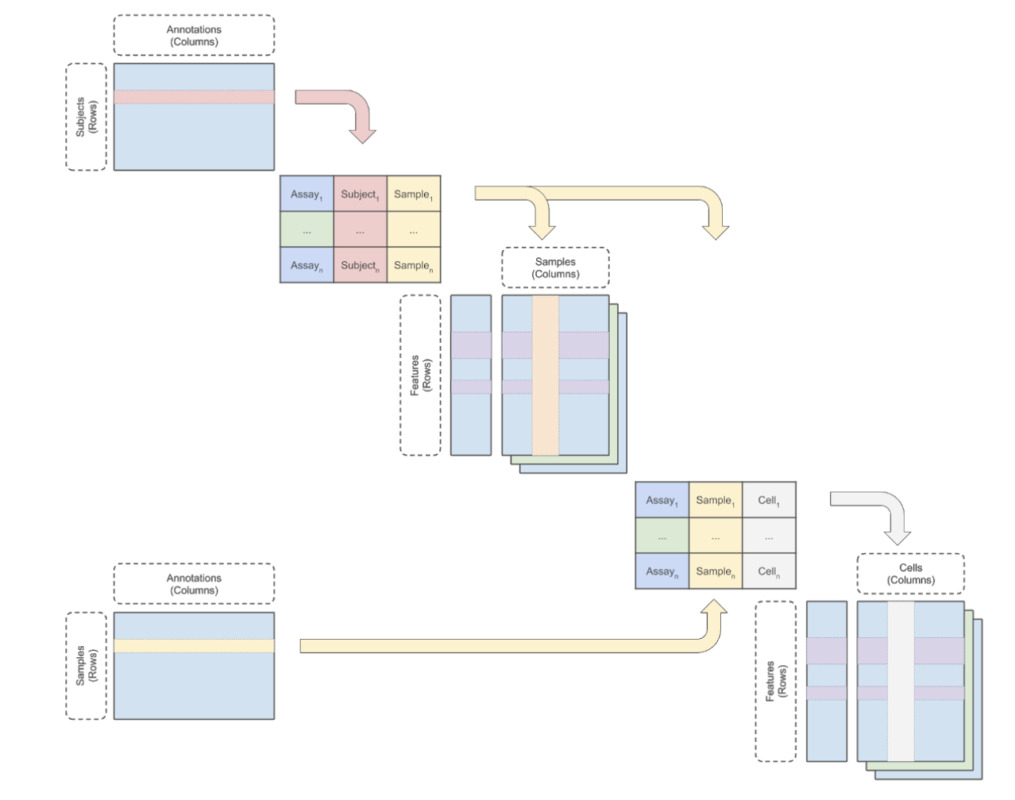
CoAssayExperiment
(current work)
Possible Data:
Single measure for each subject
Treatment, condition, sex, survival
Bulk Genomic assays
Bulk RNA-seq, DNA-seq, epigenetics, proteomics
Single cell assays (different cells)
scRNA-seq, scDNA-seq, scATAC-seq
Single cell assay (same cells)
scRNA-seq, CITE-seq

Slide 15
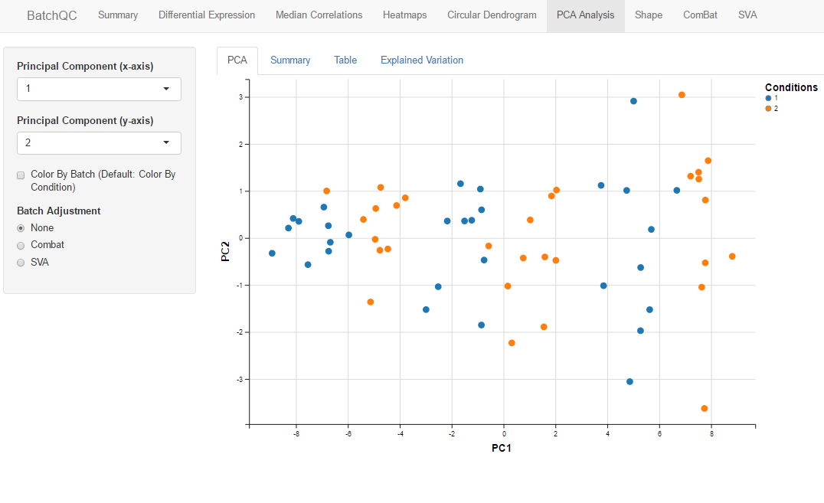
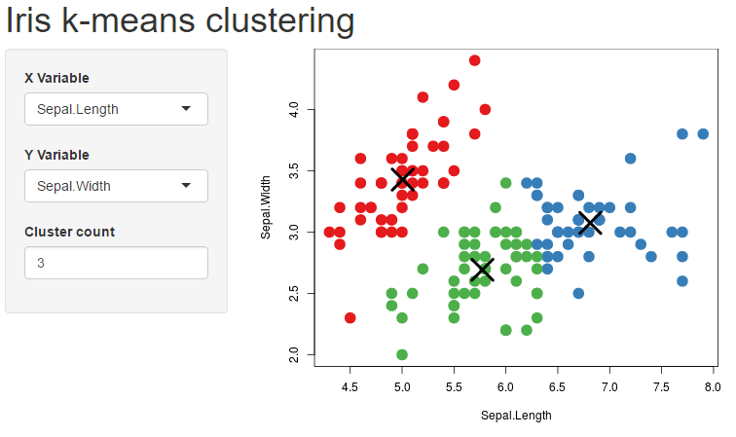
Shiny
Simple Web Apps Written in R
Interactive and Reactive
Customizable, Modular

Slide 16
SingleCellTK
Data Upload
QC and Filtering
Visualization and Clustering
ComBat Batch Correction
Differential Expression
MAST
Differential Expression
Pathway Activity Analysis
Experimental Design
Data Export
Notes:
Similar to ExpressionSet
More modern, not specifically made for microarray data, just general matrix data with row and column annotations
Can easily extend, MAST extends this object

